Slide 1
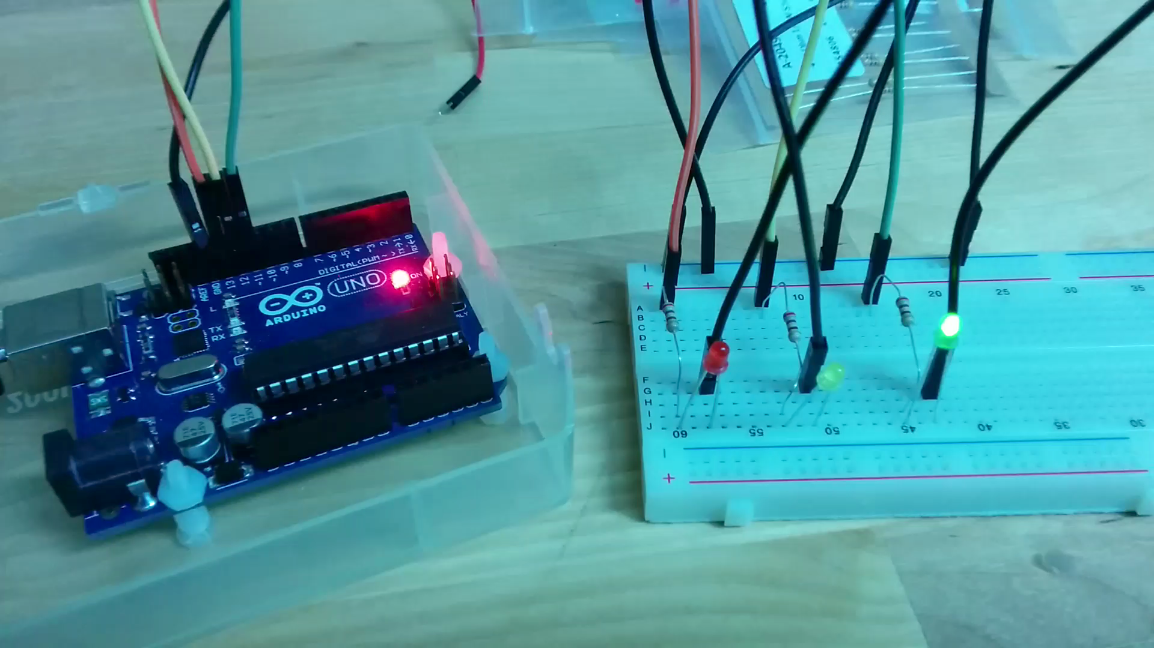
Activity #4
Arrange three LEDs (Red, Yellow and Green) in a row and make them glow like a traffic light
10 seconds Green
2 seconds Yellow
10 seconds Red
Notes:
01:40 (Optional)

Slide 2
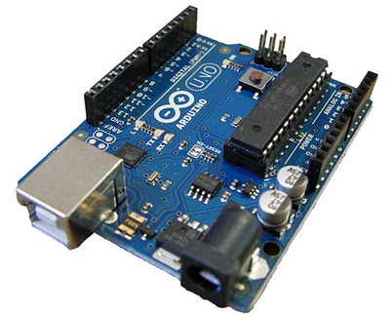
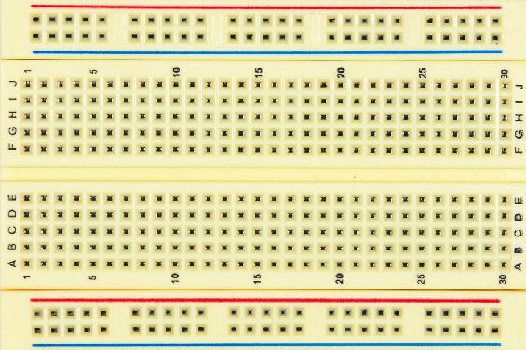
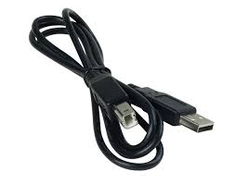
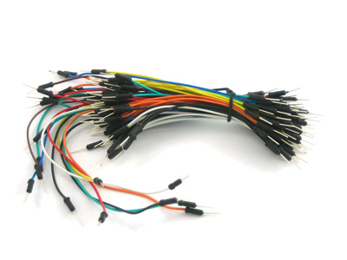
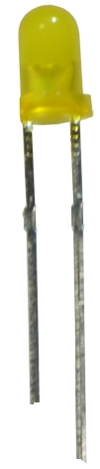
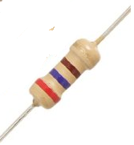

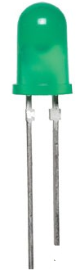
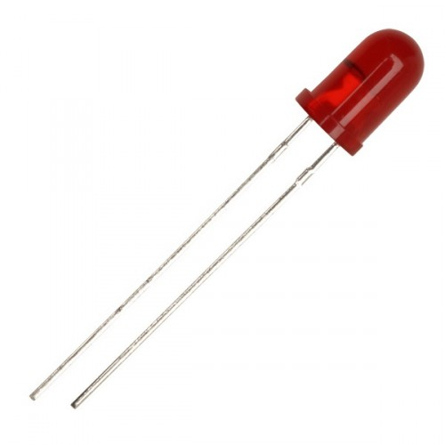
What do you need?
Arduino
Breadboard
USB cable
Brown Ring
Violet Ring
Red Ring
Wires
1 Red
1 Black
Red, Green,
Yellow L-E-D
Laptop
3 Resistors (270 ohms)

Slide 3
The circuit diagram
270 Ω
270 Ω
270 Ω
9 milli Ampere
13 12 11
Arduino
GND
G
Y
R
… in the language of the engineers !

Slide 4
Let’s build!
Connect
Port 13 to Red
Port 12 to Yellow
Port 11 to Green
Connect – ve of Board To GND on Arduino
Connect –ve leg of all LEDs to -ve of the Board
Long leg

Slide 5
Let’s build!
Connect – ve of Board To GND on Arduino
Connect
Port 13 to Red LED’s resistor
Port 12 to Yellow LED’s Resistor
Port 11 to Green LEDs resistor
Connect USB cable

Slide 6
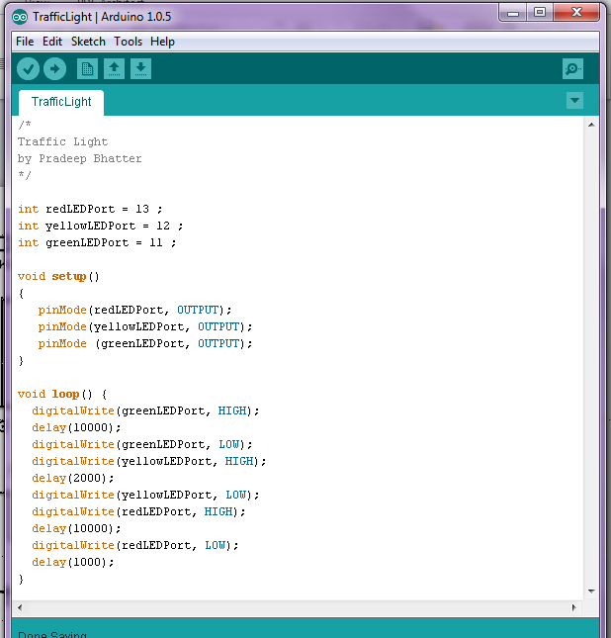
Sketch
Click on Upload to send the instructions from the computer to Arduino
Verify instructions were
Uploaded!!
And there were no errors
........

Slide 7
int redLEDPort = 13 ;
int yellowLEDPort = 12 ;
int greenLEDPort = 11 ;
void setup()
{
pinMode(redLEDPort, OUTPUT);
pinMode(yellowLEDPort, OUTPUT);
pinMode (greenLEDPort, OUTPUT);
}
void loop() {
digitalWrite(greenLEDPort, HIGH);
delay(10000);
digitalWrite(greenLEDPort, LOW);
digitalWrite(yellowLEDPort, HIGH);
delay(2000);
digitalWrite(yellowLEDPort, LOW);
digitalWrite(redLEDPort, HIGH);
delay(10000);
digitalWrite(redLEDPort, LOW);
delay(1000);
}

Slide 8
Did it work?

